Slide 1
Data Heterogeneity in Federated Learning
CSCI 8980 Project
Presenter: Chen Hu and Yuchuan Huang

Slide 2
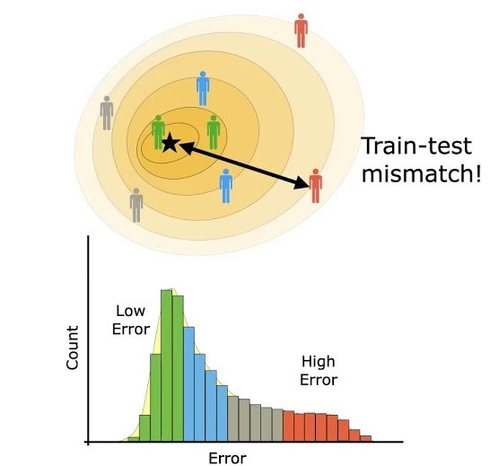
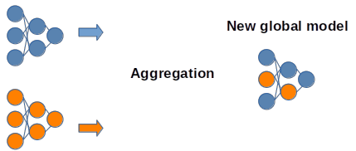
Introduction
Statistical/data heterogeneity in federated learning
Each client has non-identically and independently distributed (non-IID) data
decrease accuracy
affect training efficiency
avoid personalized prediction
create bias

Slide 3
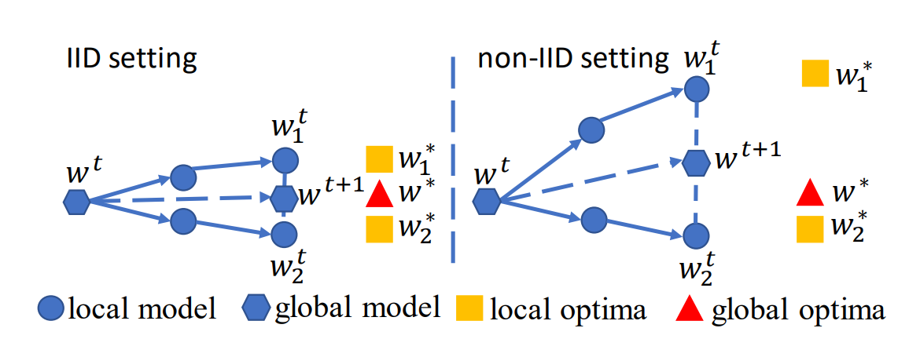
Related Work
Different data skew scenarios:
Federated Learning on Non-IID Data Silos: An Experimental Study
Label distribution skew
Each client has the same amount of data, but their label distribution are different
Quantity skew
Each client has the same distribution, but some clients have more/less data
Feature distribution skew

Slide 4
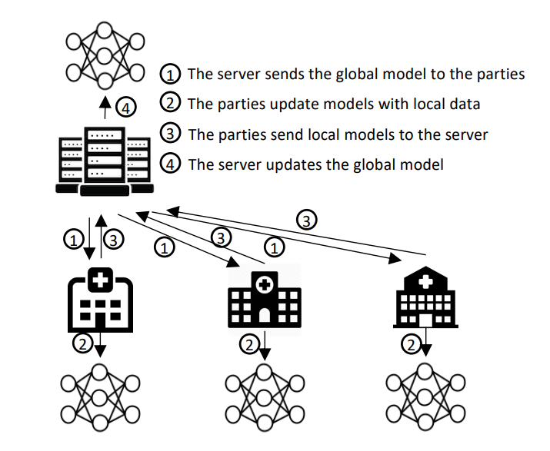
Related Work
Different algorithms:
FedAvg Communication-Efficient Learning of Deep Networks from Decentralized Data
FedProx Federated Optimization in Heterogeneous Networks
FedNova Tackling the Objective Inconsistency Problem in Heterogeneous Federated Optimization
SCAFFOLD SCAFFOLD: Stochastic Controlled Averaging for Federated Learning
Either changing local updating function or global averaging function.

Slide 5
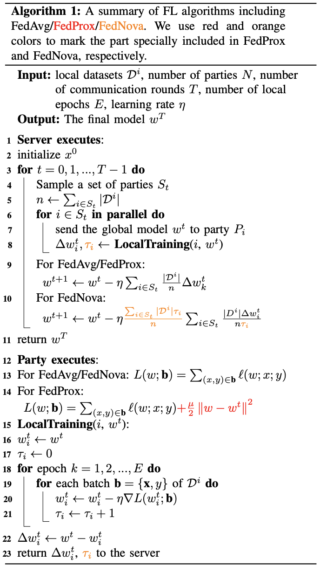
Our Proposal: FedMix
FedMix = FedNova + FedProx
FedNova only tweaks the server
FedProx only tweaks the client
Can we combine them together?
Federated Learning on Non-IID Data Silos: An Experimental Study. ICDE 2022

Slide 6
Experiment Design
Generate heterogeneous data
Test FedAvg
Test FedNova, FedProx
Test FedMix

Slide 7
Implementation
On top of homework 1 (PyTorch + Flask)
https://github.com/csci8980/fl

Slide 8
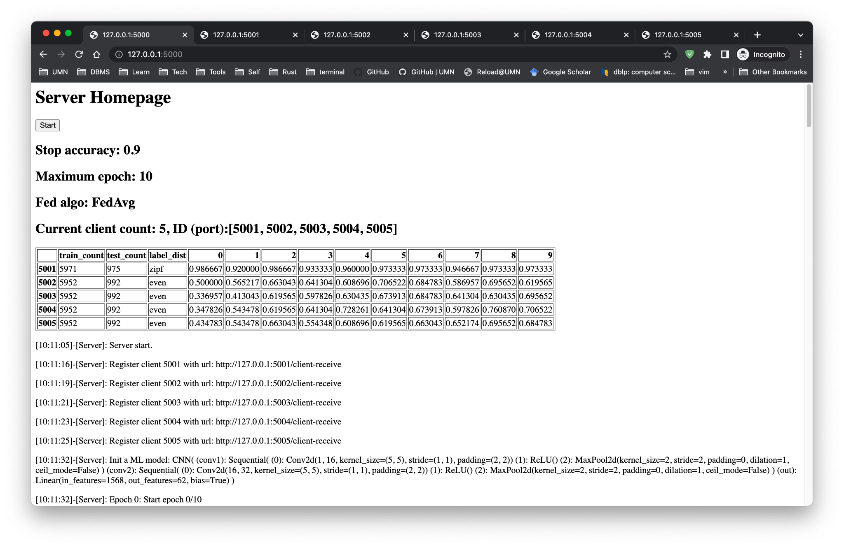

Slide 9
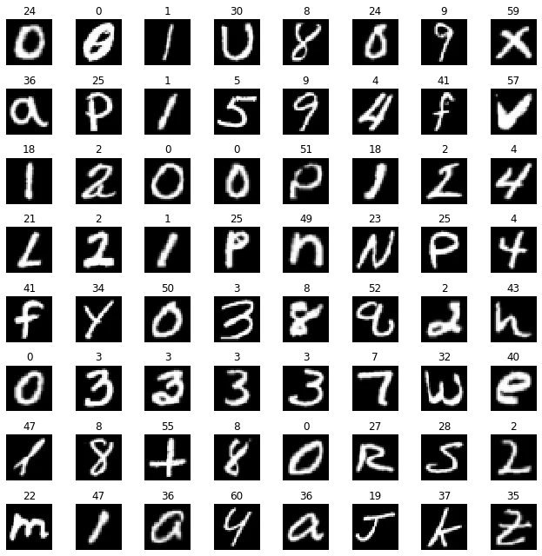
Dataset
EMNIST
62 classes: 0-9, A-Z, a-z
https://pytorch.org/vision/stable/generated/torchvision.datasets.EMNIST.html#torchvision.datasets.EMNIST

Slide 10
Heterogeneous Dataset Generation
Label Distribution
Even
Zipf
Data Quantity
“More”: 6000 train, 1000 test
“Less”: 600 train, 100 test
Example:
a “zipf_more” dataset has Zipf label distribution with 6000 training data and 1000 testing data

Slide 11
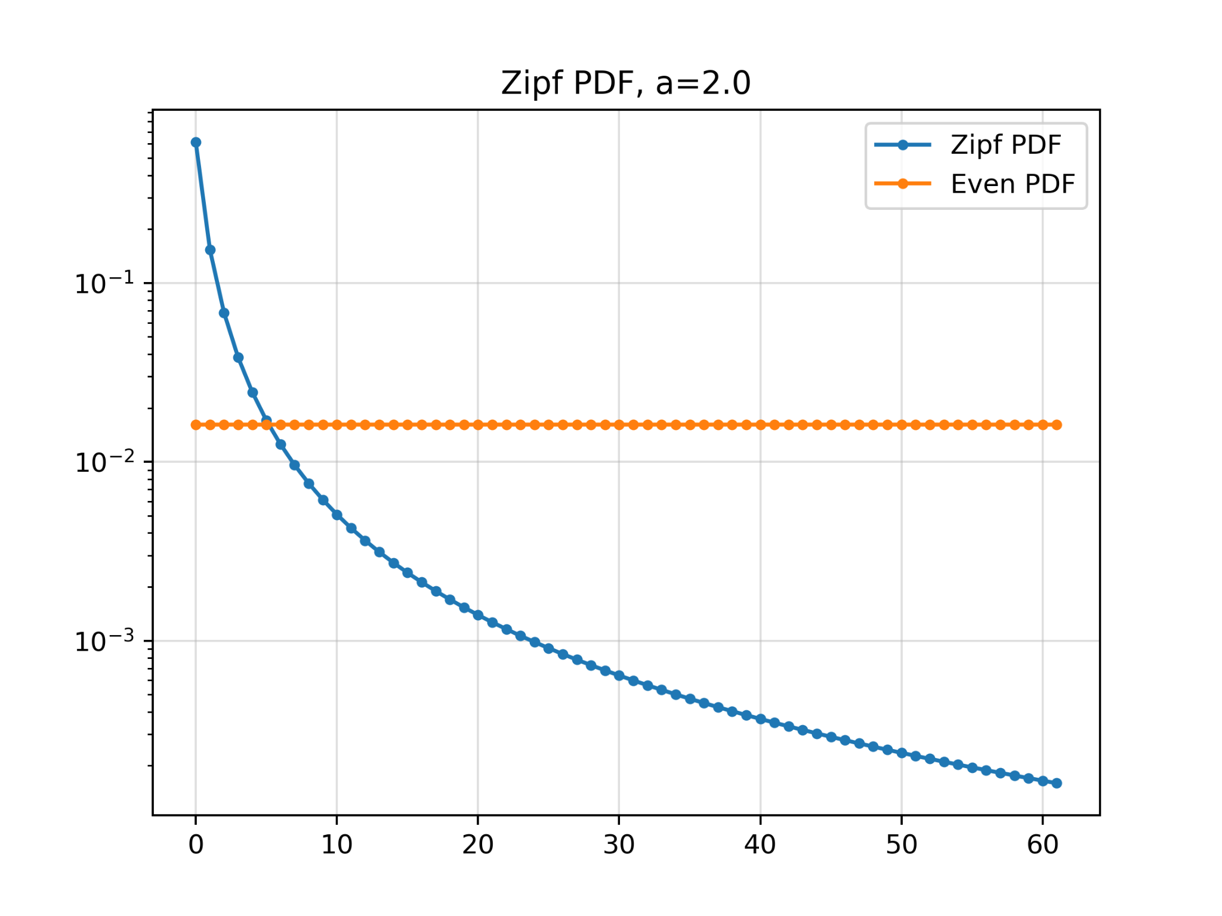
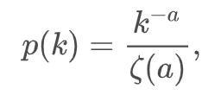
Even VS Zipf
E.g., 6000 training data, 62 classes
Even: 96 data per class
Zipf: 3683, 920, 409, 230, 147, 102, 75, ...…, 1, 1, 1, 1, 1, 1

Slide 12
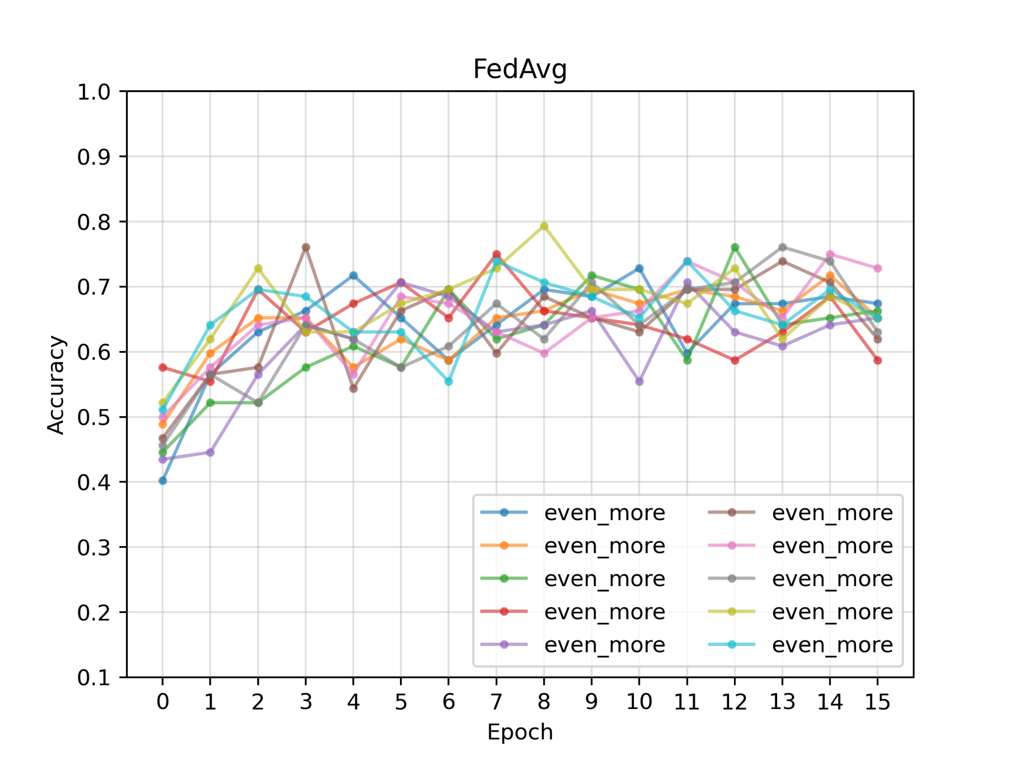
FedAvg
10 “even_more” clients
Accuracy: 0.6 - 0.7

Slide 13
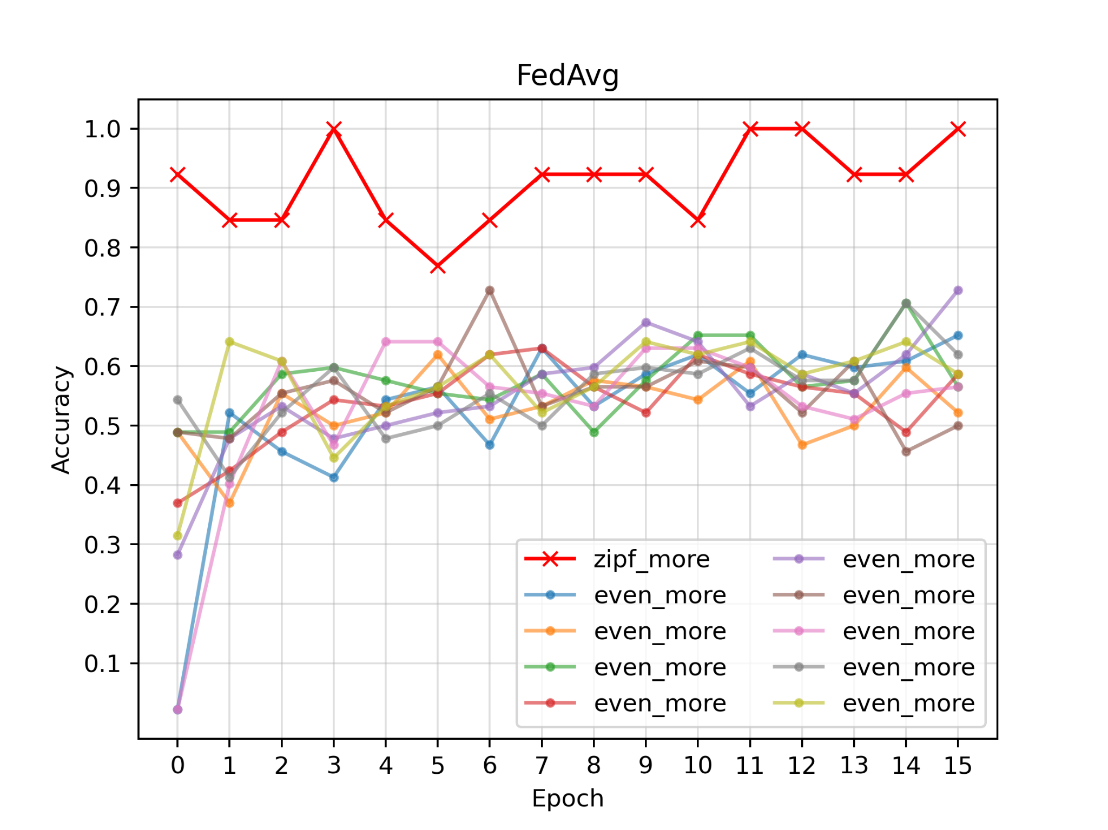
FedAvg
1 “zipf_more”+ 9 “even_more”
zipf_more: above 0.9
even_more: 0.5 - 0.7

Slide 14
FedAvg on heterogeneous label distribution
Conclusion 1: Skewed client itself has good accuracy, but hurts other clients.

Slide 15
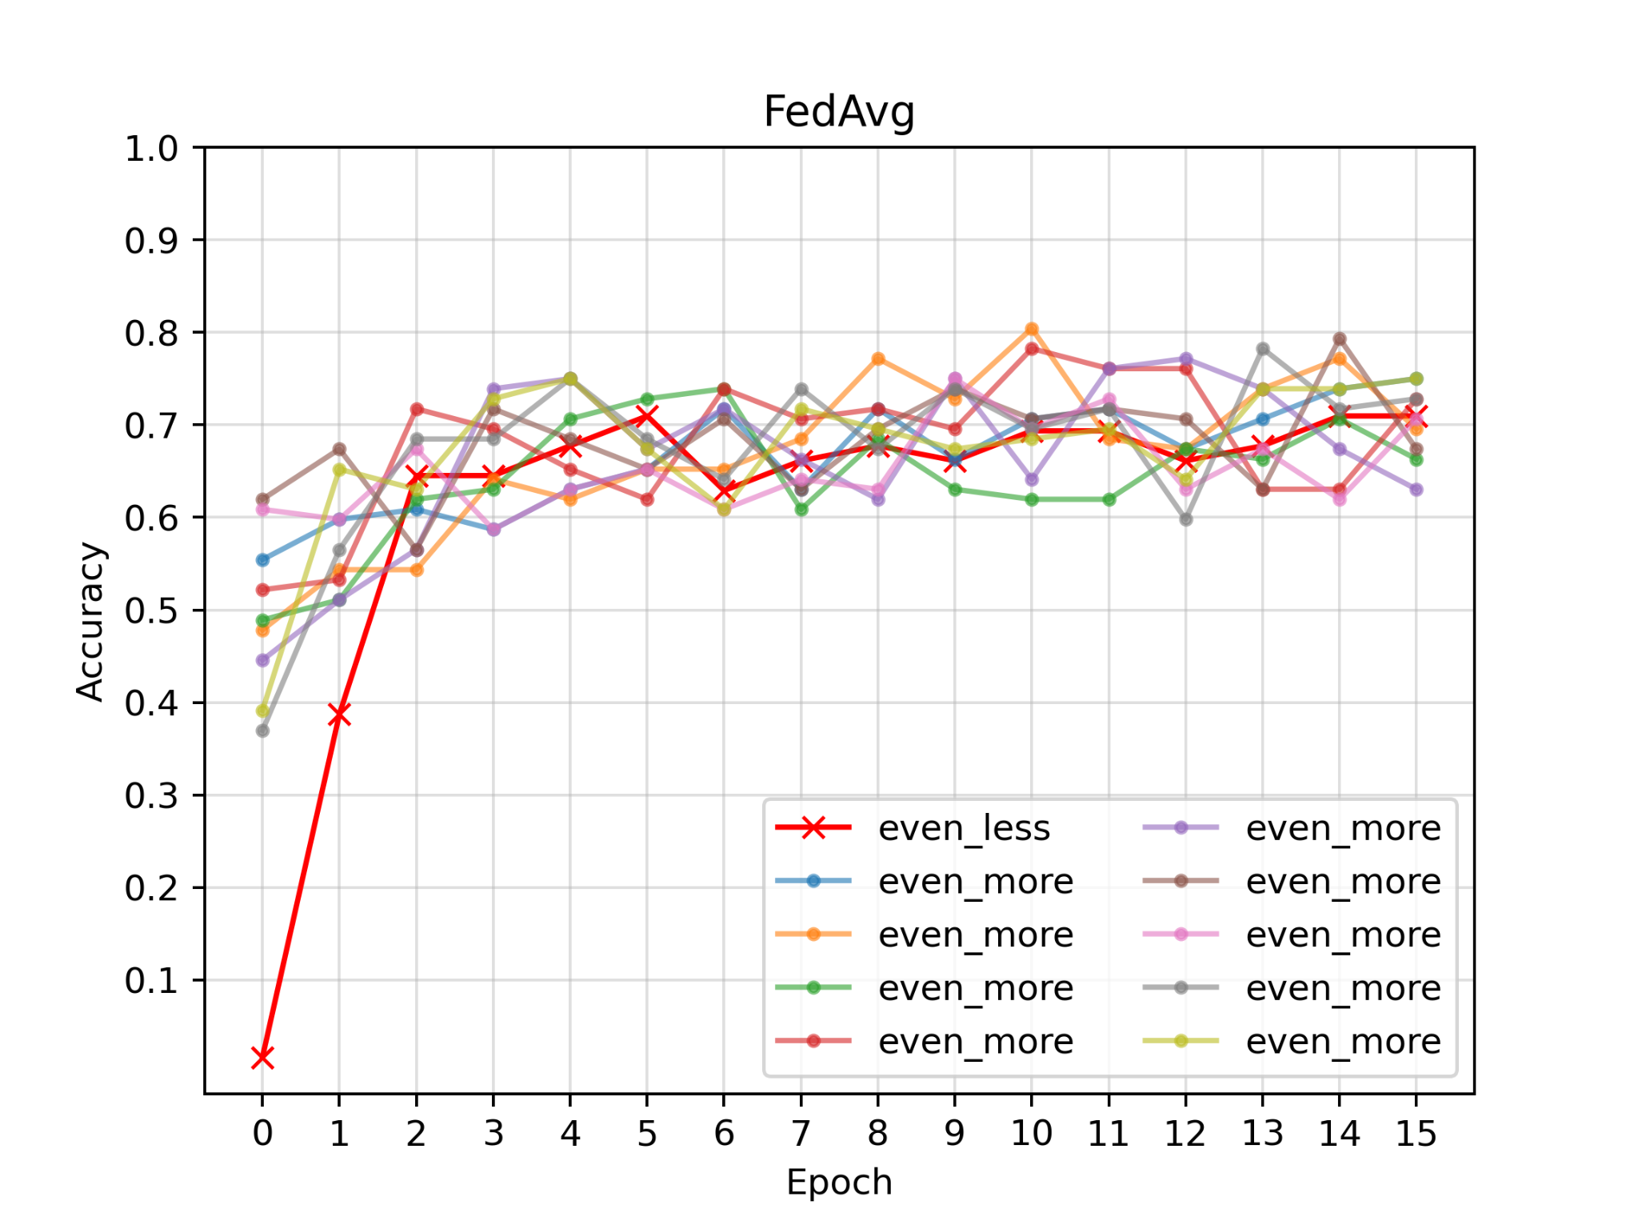
FedAvg
1 “even_less”+ 9 “even_more”
Accuracy: 0.6 - 0.7

Slide 16
FedAvg on heterogeneous data quantity
Conclusion 2: Insufficient client has poor accuracy at first several epochs, but other clients can help it.

Slide 17
Conclusion so far
Heterogeneous label distribution does hurt FL performance.
Heterogeneous data quantity does not hurt a lot.
Next, we’ll show how different fusion algorithms performance on heterogeneous class distribution.

Slide 18
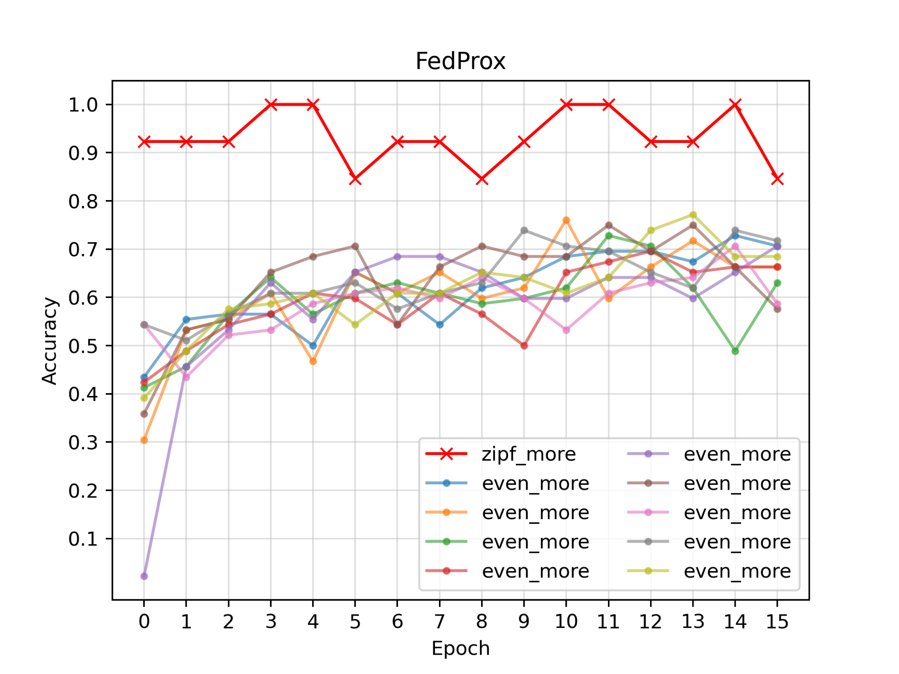
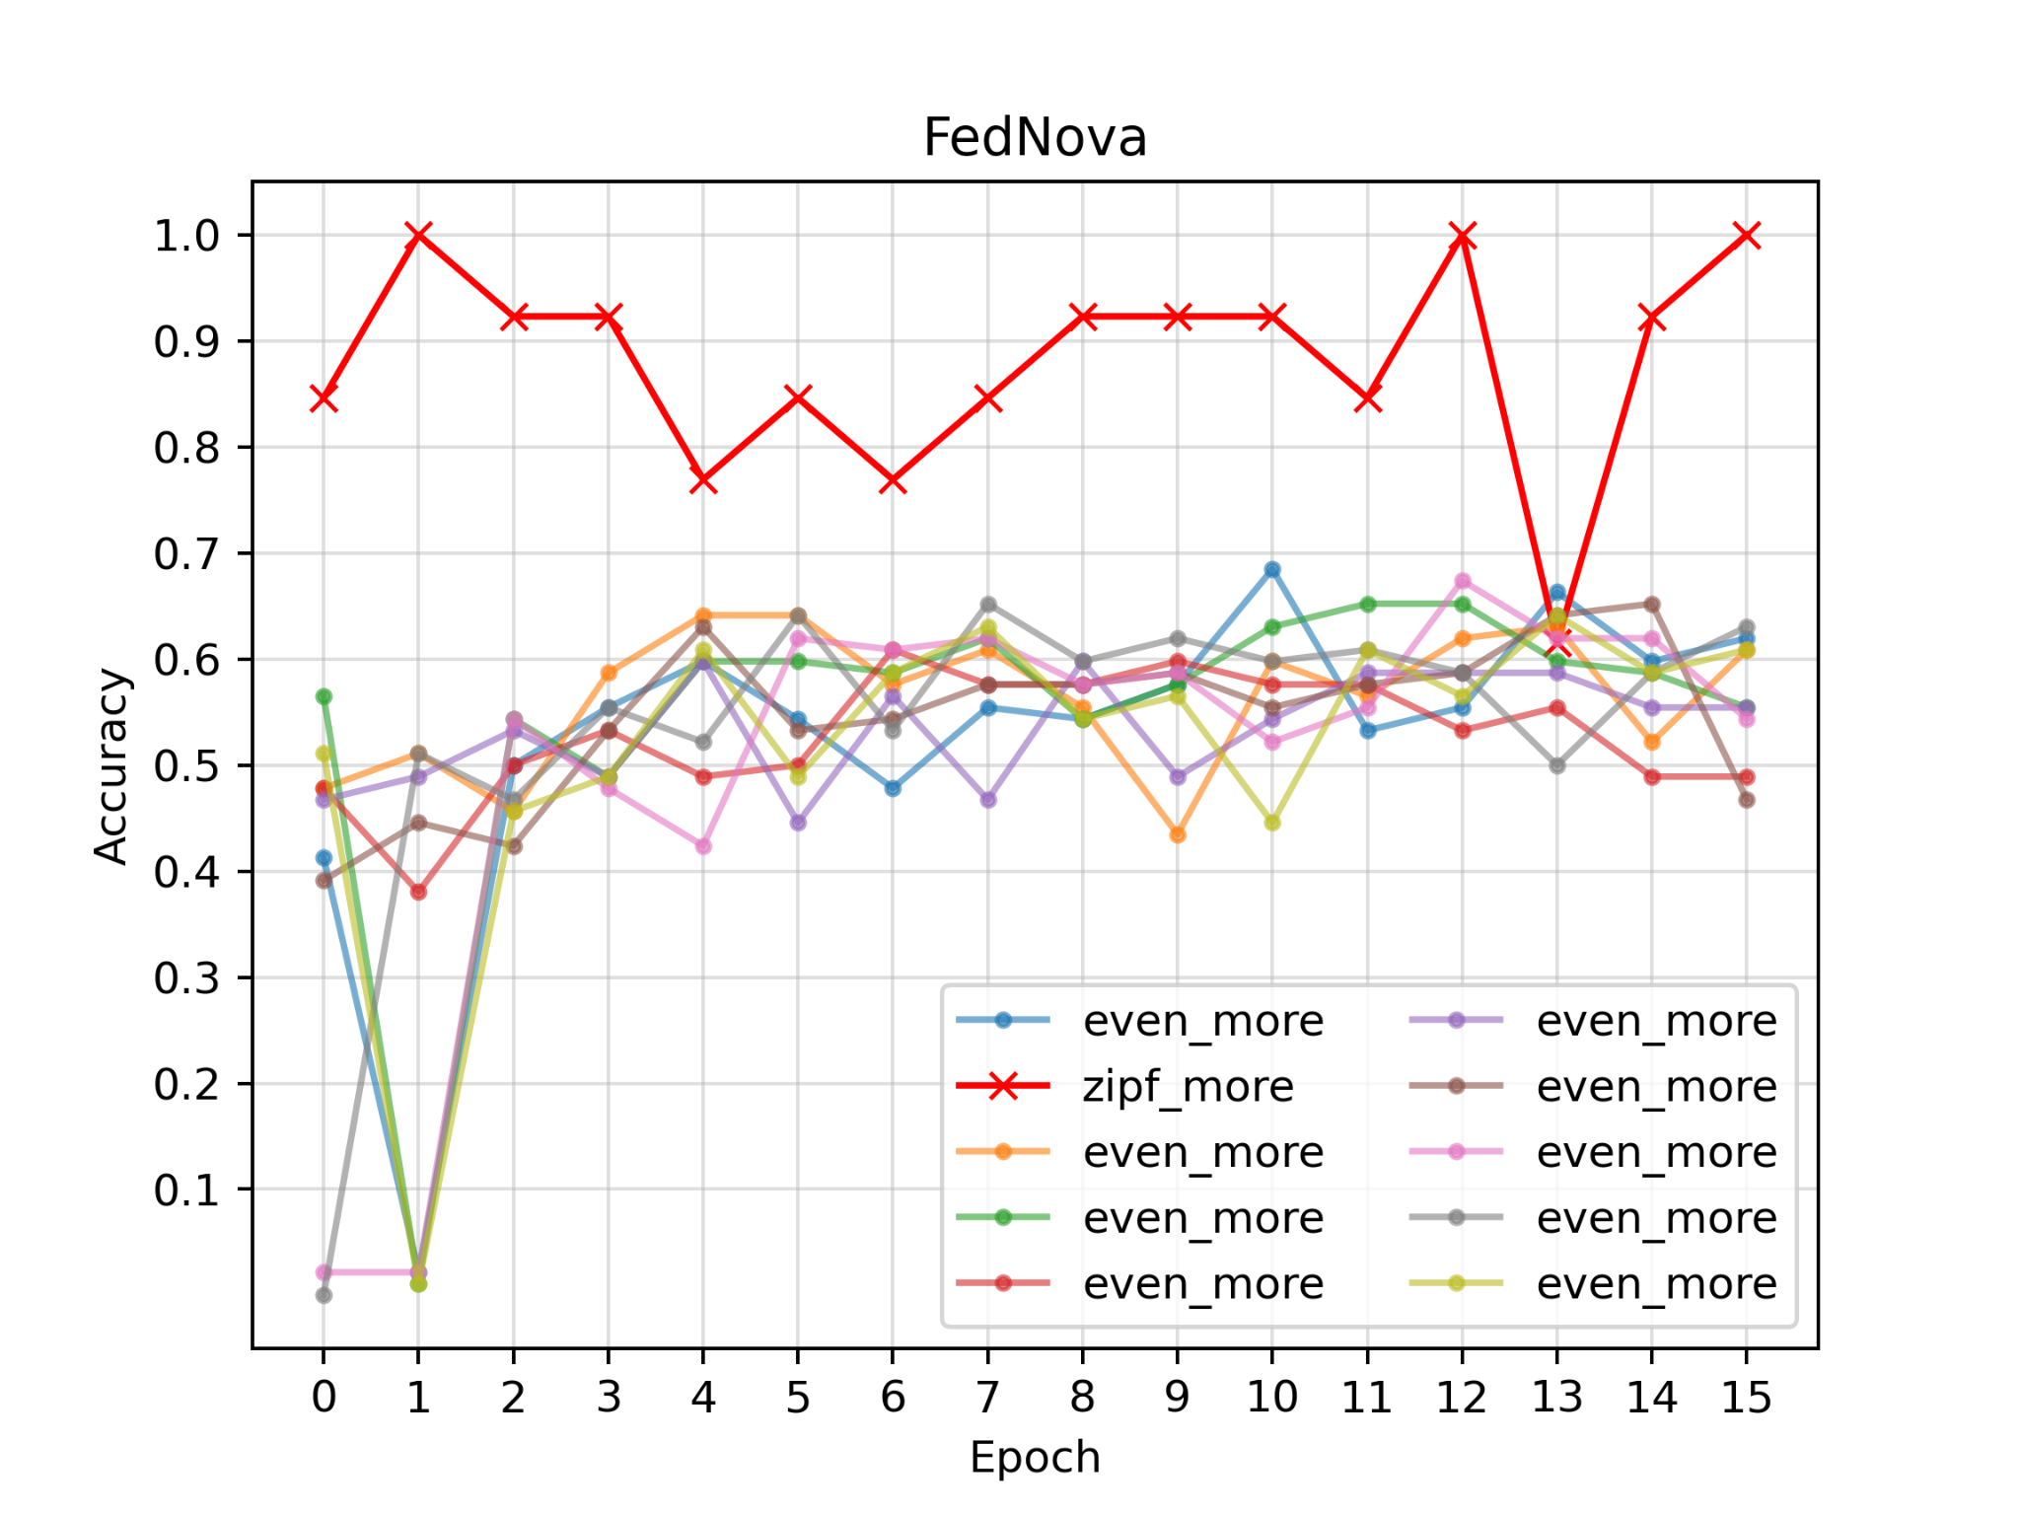
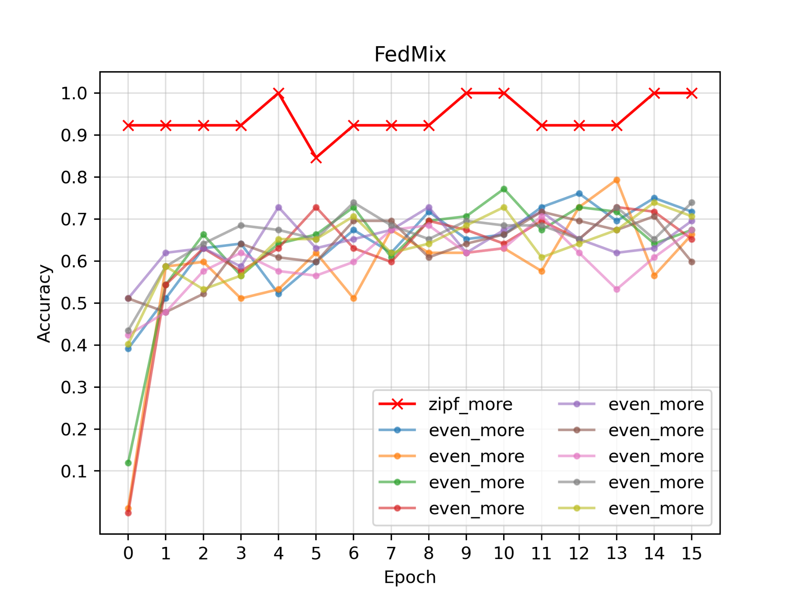
1 “zipf_more”
9 “even_more”
Zipf: 0.9-1.0
FedAvg: 0.5-0.7
FedProx: 0.6-0.7
FedNova: 0.5-0.6
FedMix: 0.6-0.7

Slide 19
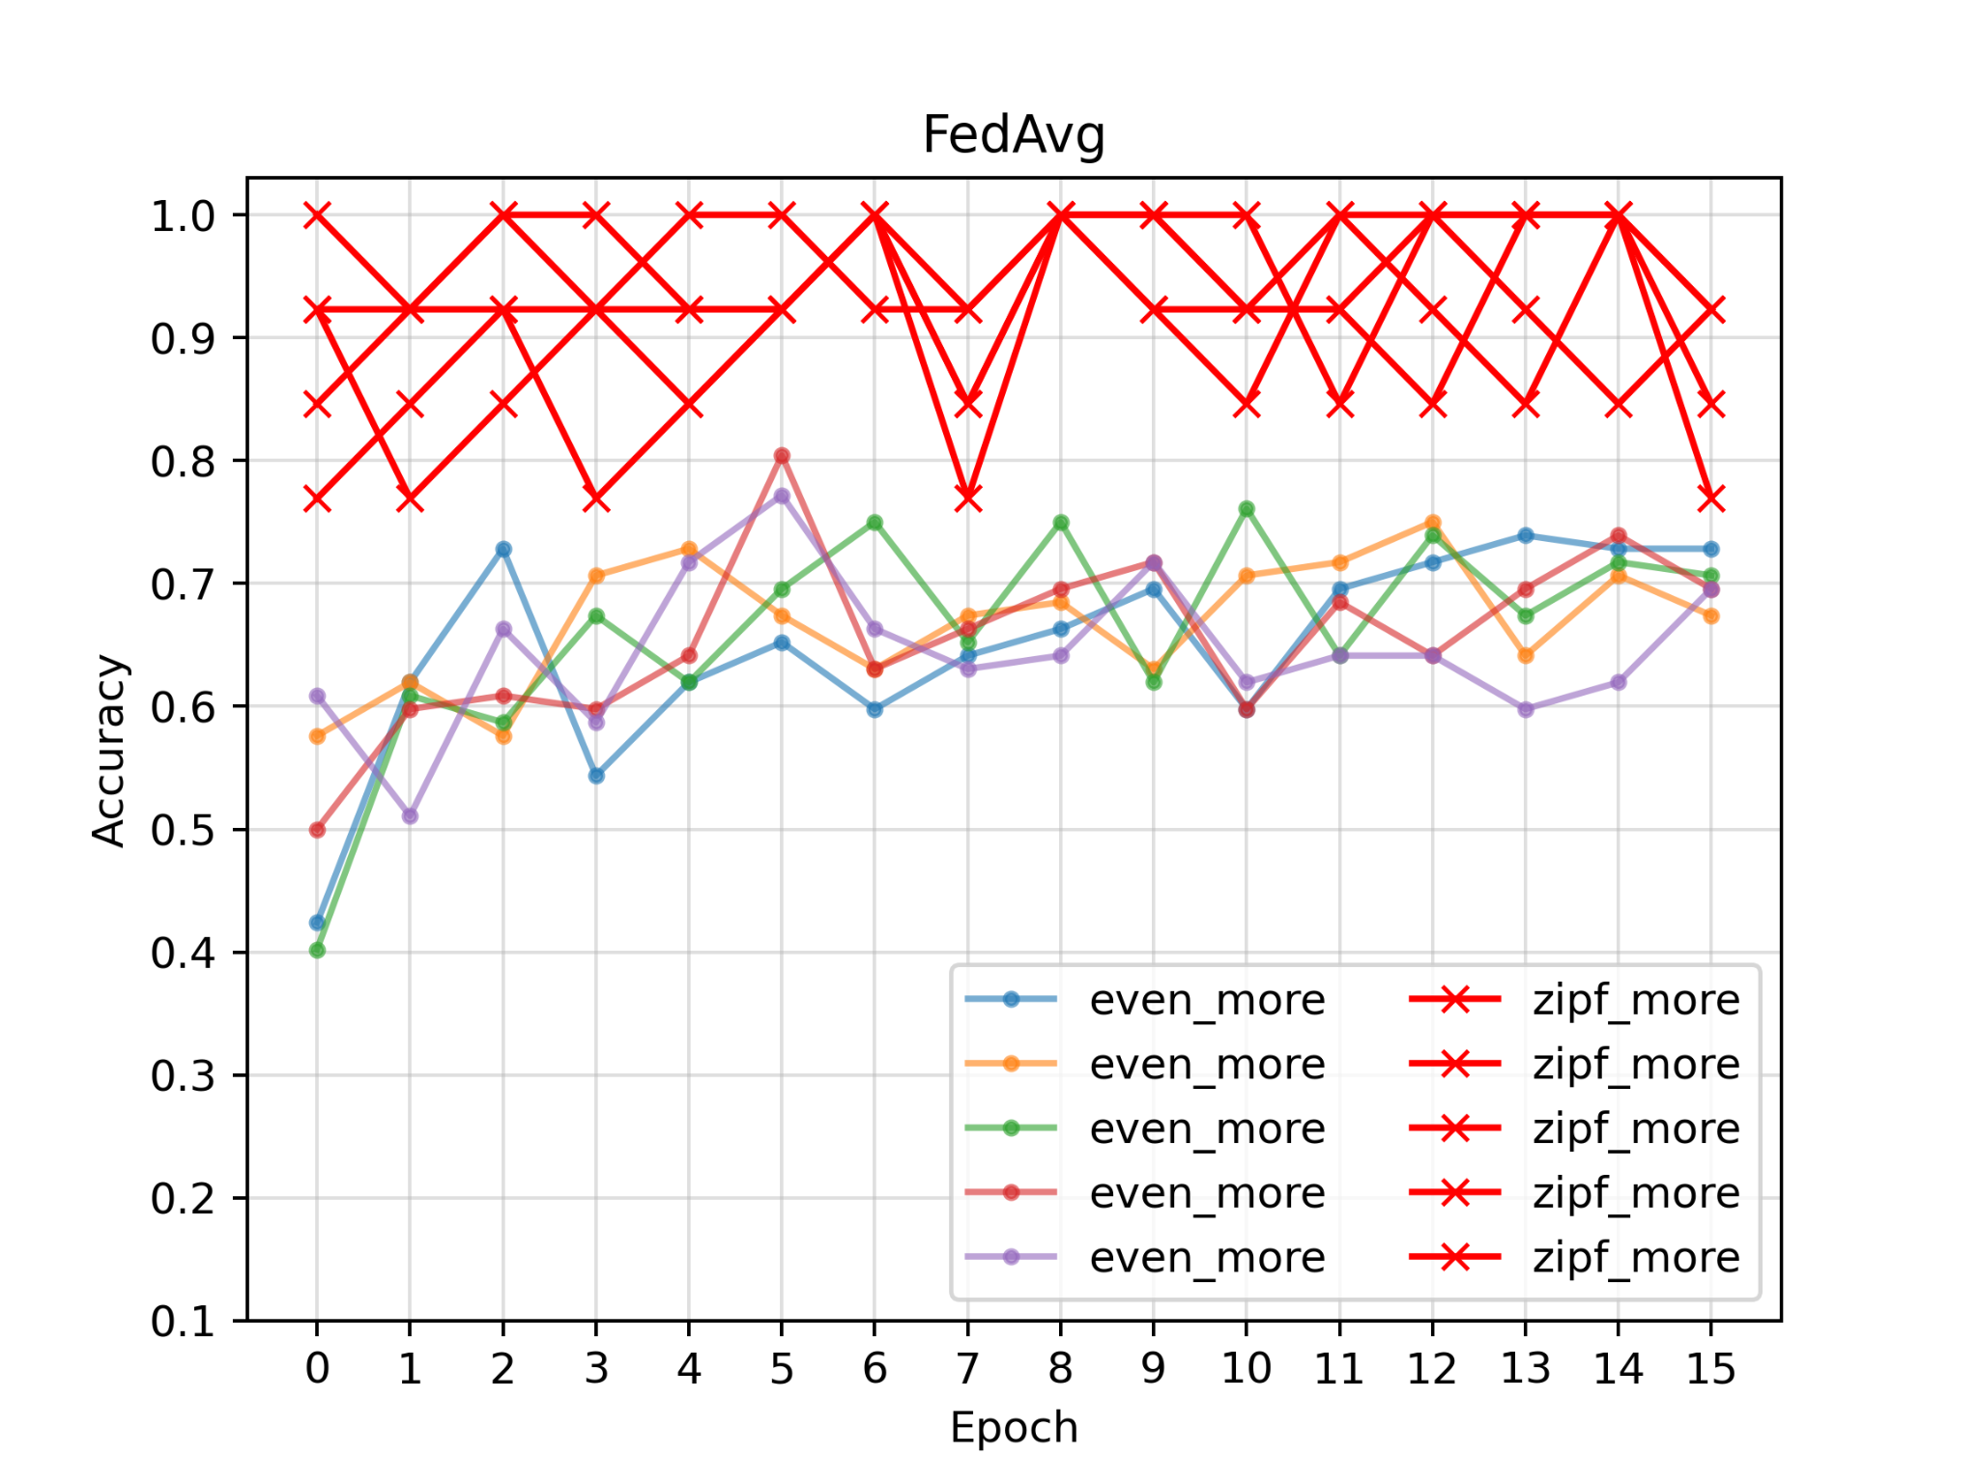
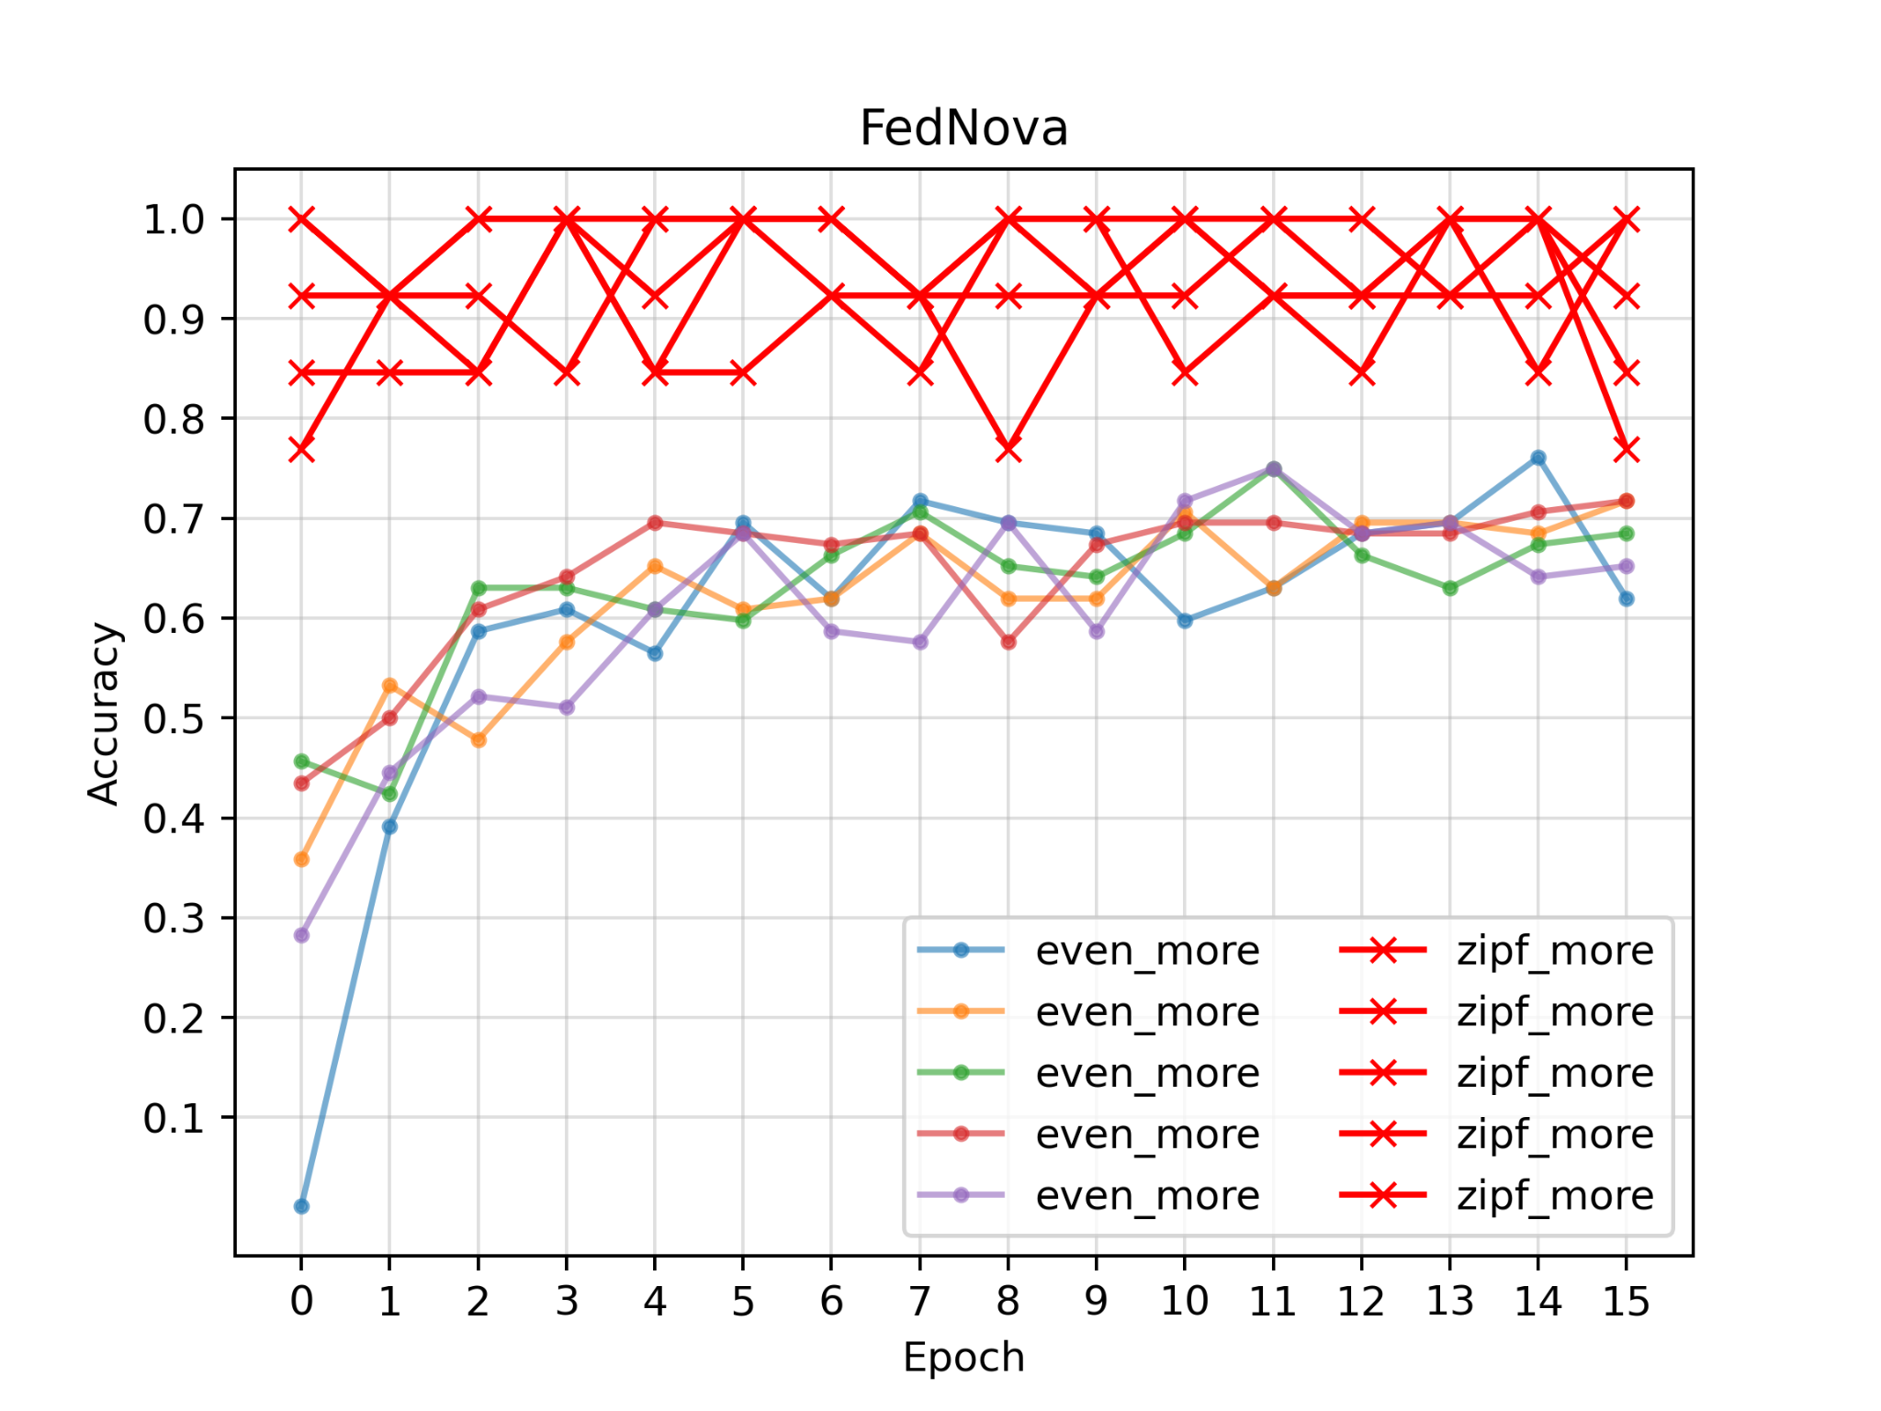
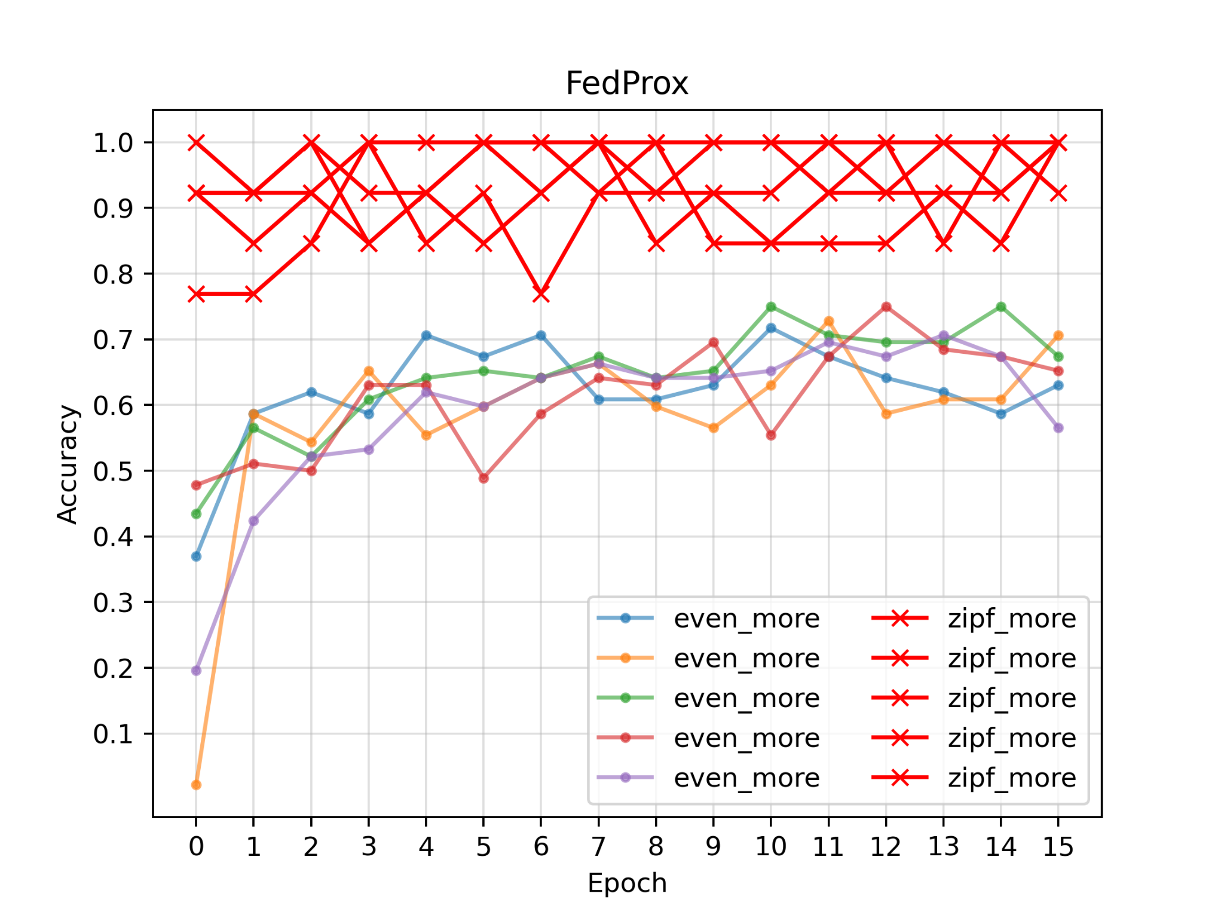
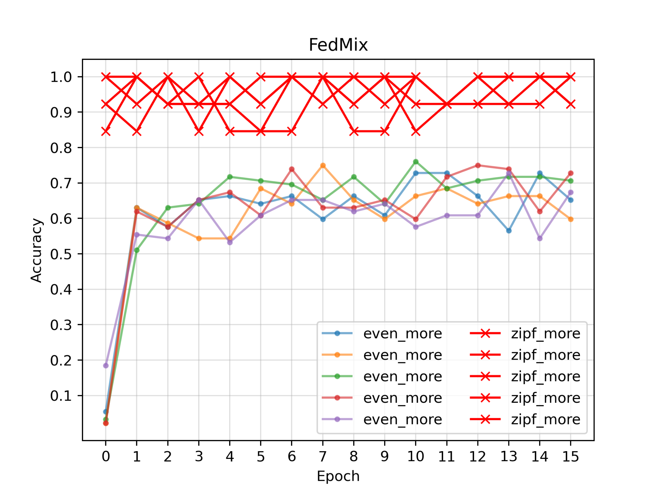
5 “zipf_more”
5 “even_more”
Zipf: 0.8-1.0
Even: 0.6-0.7

Slide 20
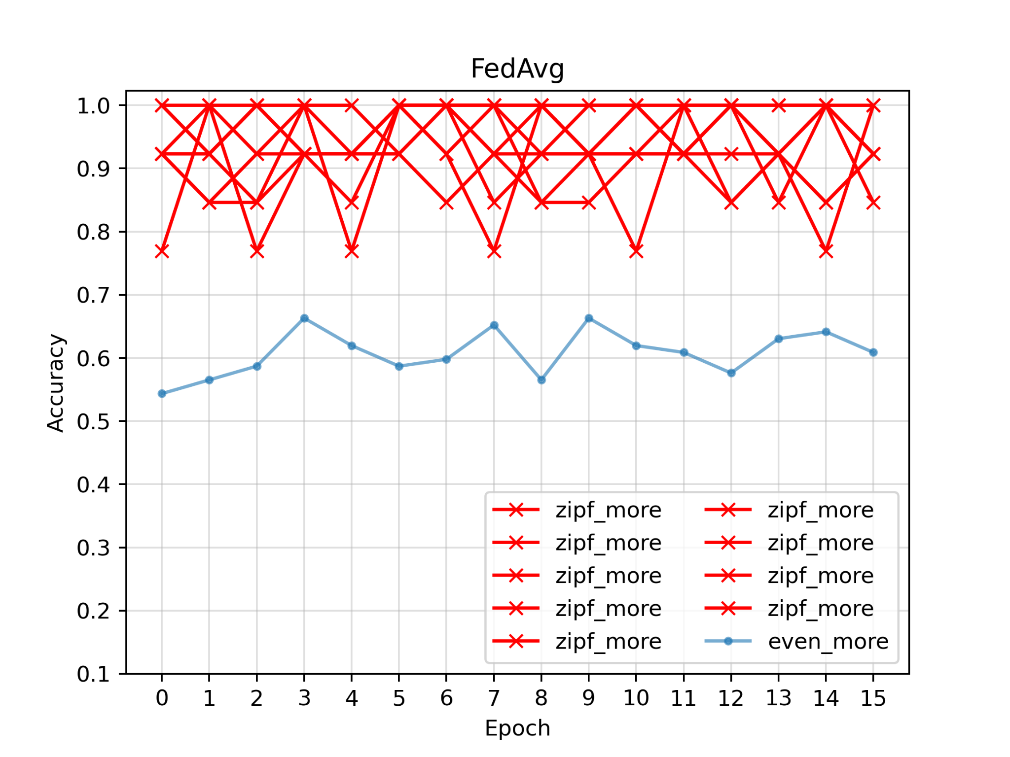
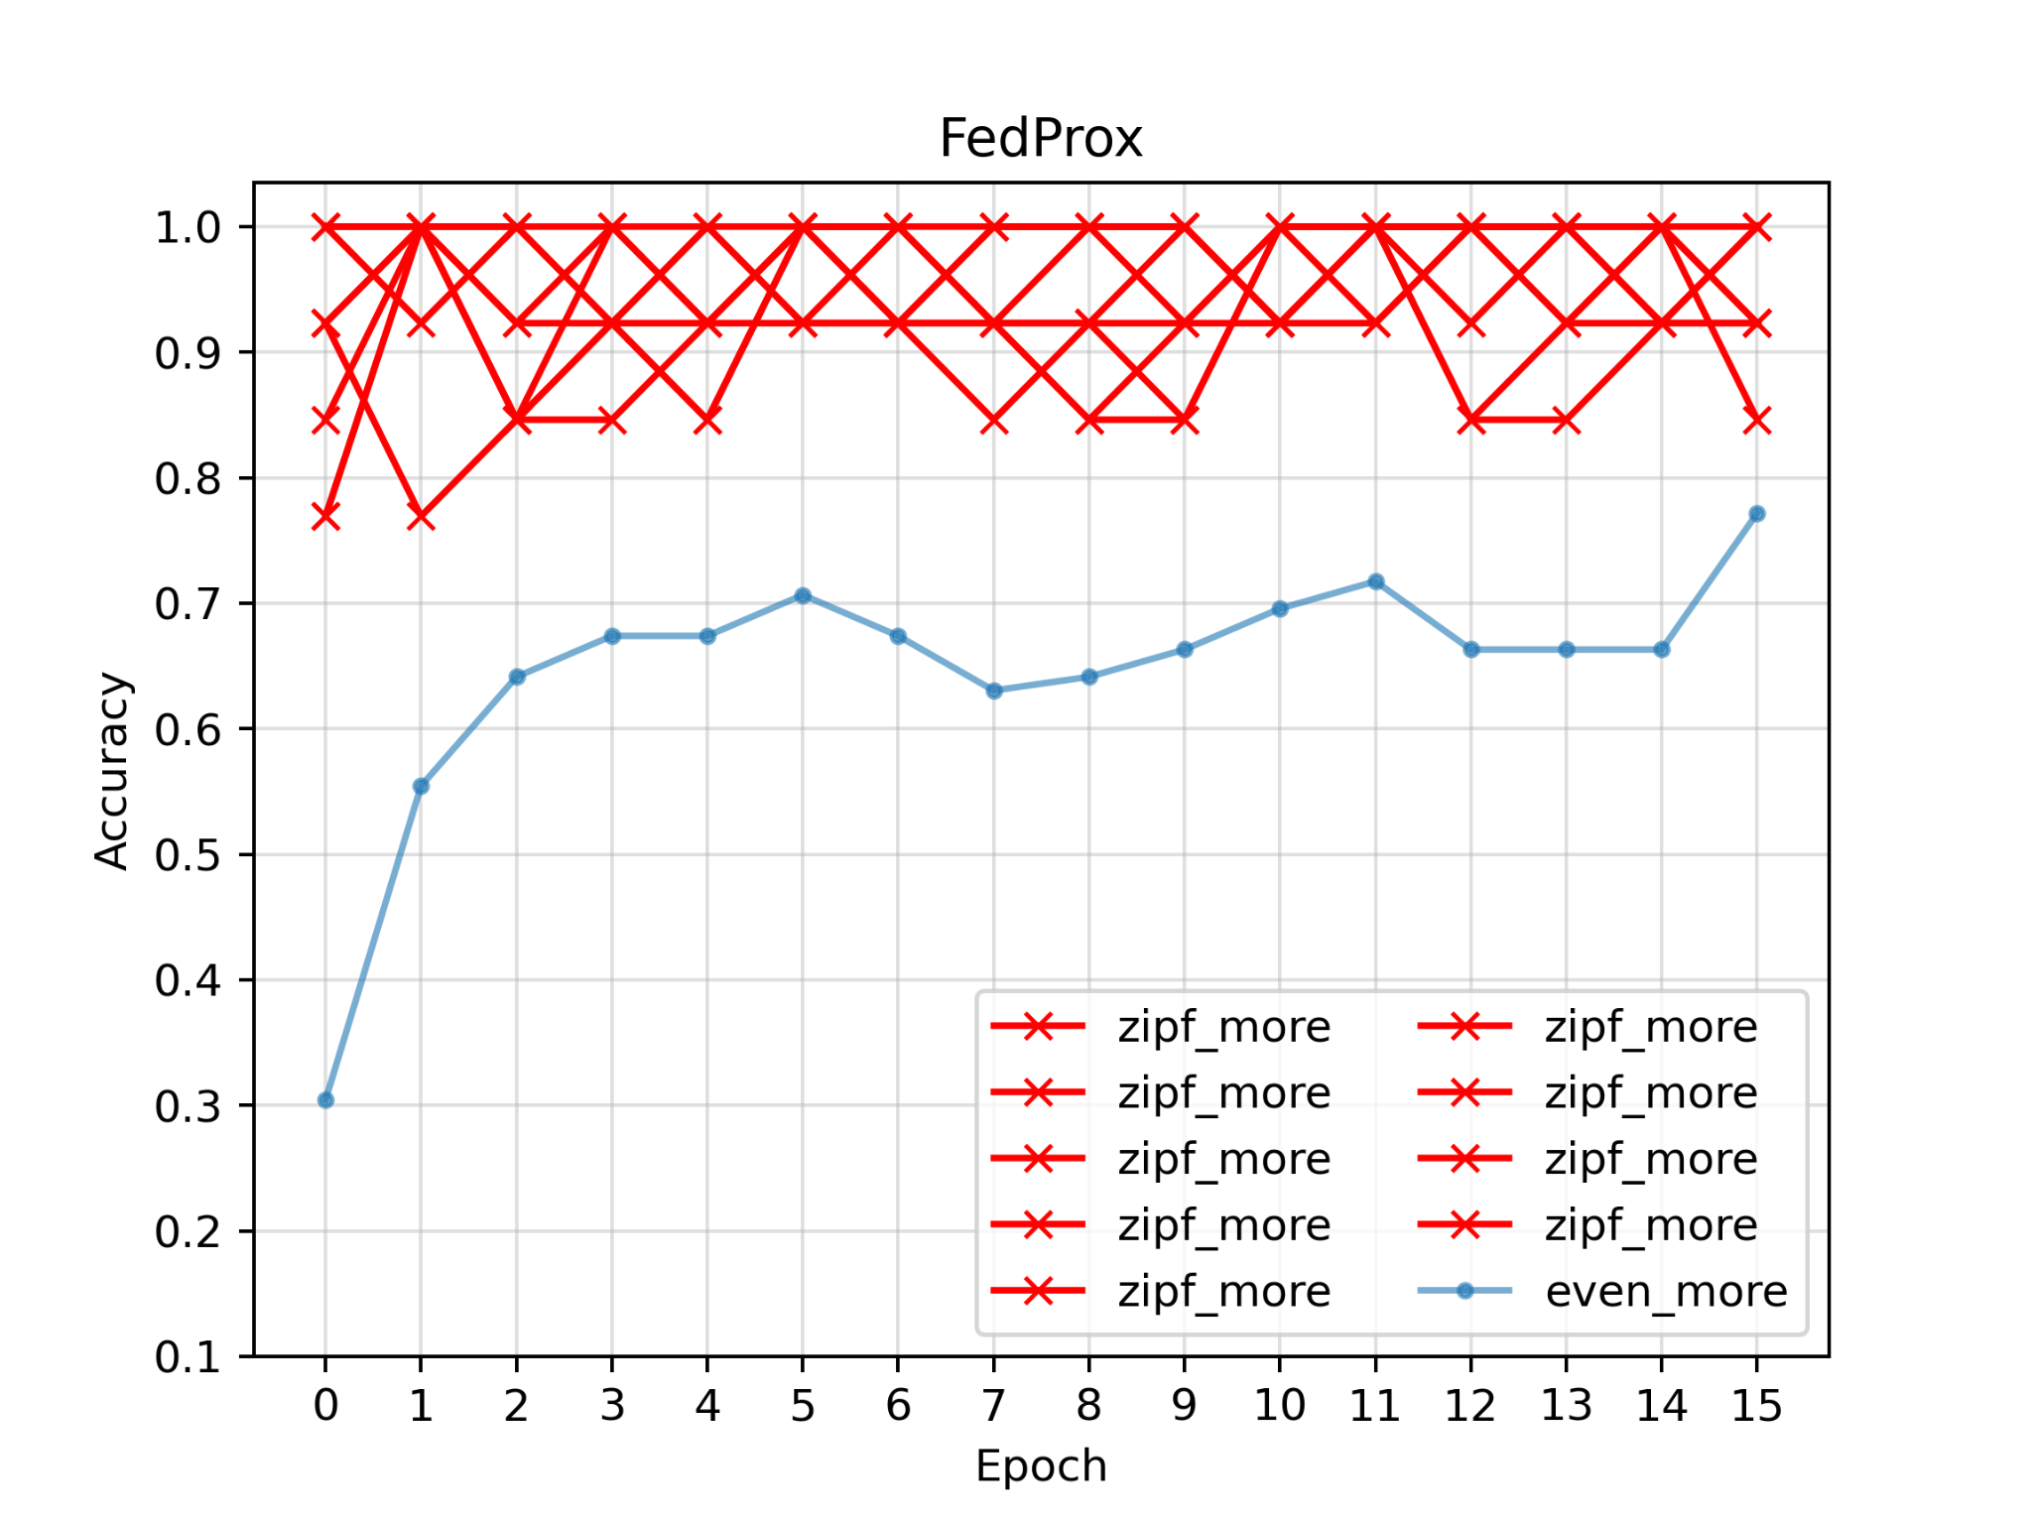
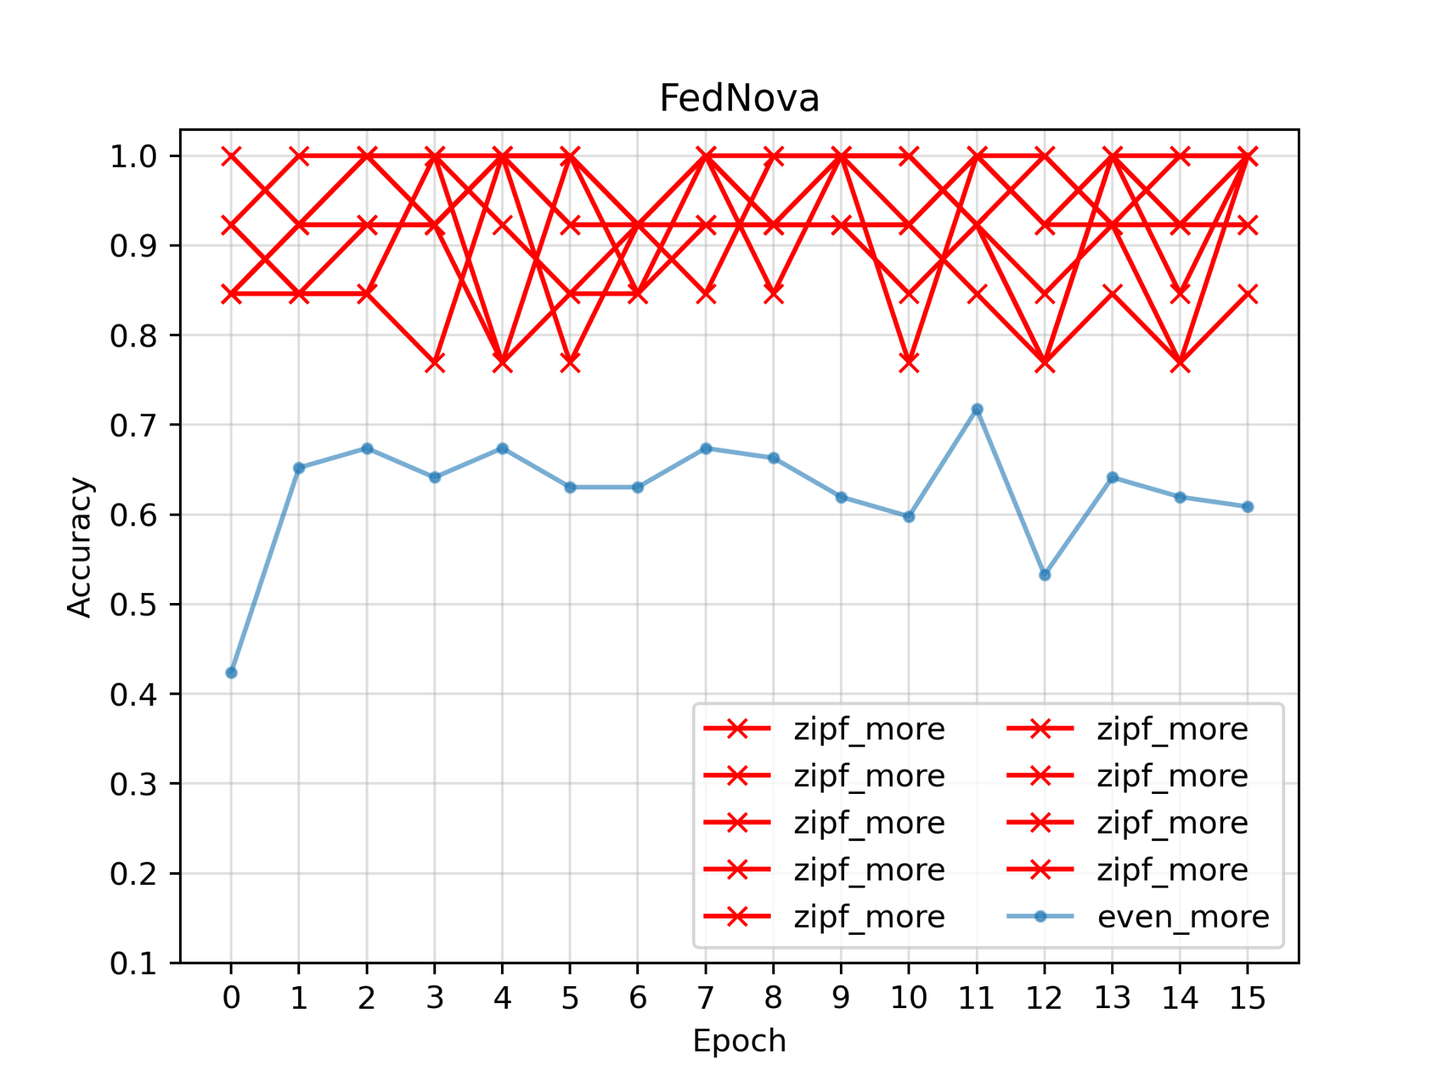
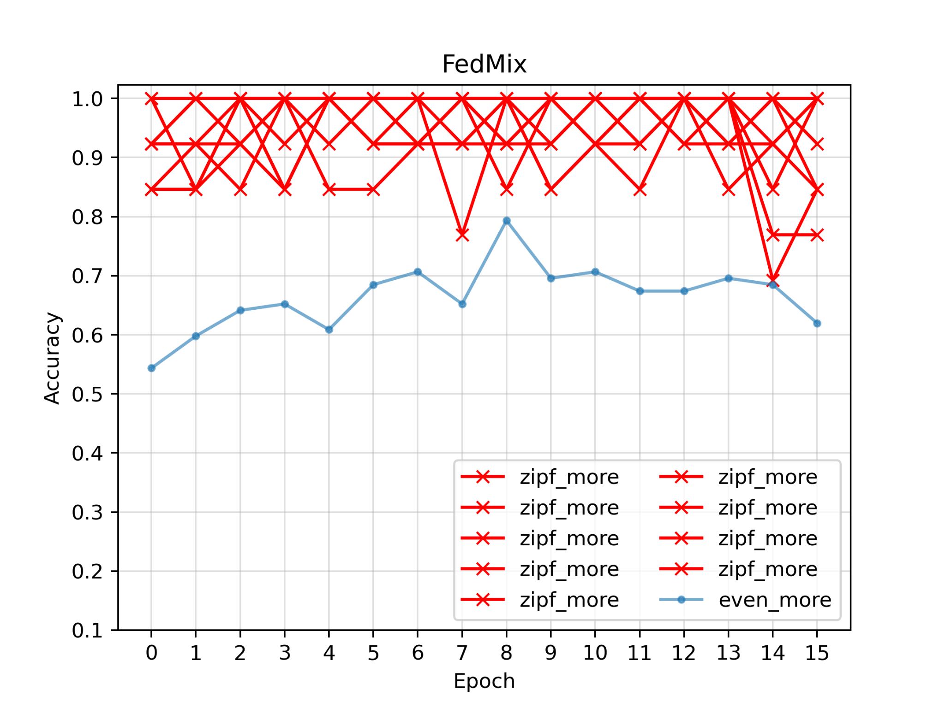
9 “zipf_more”
1 “even_more”
Zipf: 0.8-1.0
Even: 0.6-0.7
FedProx: 0.7-0.8

Slide 21
Conclusion 2nd
FedNova, FedProx do not show significant advantage over FedAvg
FedProx performs slightly better than FedNova, FedAvg
FedMix has performance similar to FedProx, maybe an inheritance
Maybe client side tweak is more effective than server side tweak

Slide 22
Discussion
For skew dataset, accuracy may not be the best measurement since dataset is pretty imbalance. Precision, recall and F1 need to be considered.
FedProx, FedNova or FedMix don’t outperform FedAvg, even this was stated by several researches.
For heterogeneous dataset, there might not be a universal best algorithm so far since there are a lot of different heterogeneous cases.

